Slide 1
CSE 11 Accelerated Intro to Programming Lecture 1
Greg Miranda, Summer 1 2021
This lecture is being recorded

Slide 2
Fair Notice of Class Recording Announcement
Each class online lecture for CSE 11, including this one, will be recorded and made available to students asynchronously.

Slide 3


About Me and My Family :)
Full name: Gregory Miranda Preferred name: Greg Preferred pronouns: he/him/his Personal webpage: https://gregmiranda.com

Slide 4
Education
M.S. in Technology (Artificial Life Programming)
B.S. in Computer Engineering

Slide 5
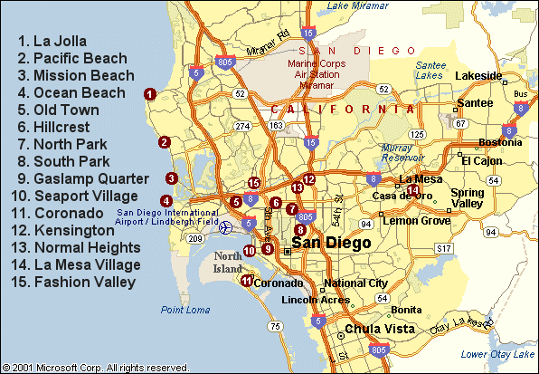

Where am I from

Slide 6
Teaching Experience
UCSD
CSE 3 – Fluency in Information Technology
CSE 5A – Introduction to Computer Science (C)
CSE 8B – Introduction to Programming and Computational Problem-Solving II
CSE 11 – Introduction to Programming and Computational Problem-Solving: Accelerated Pace
CSE 12 – Basic Data Structures and Object-Oriented Design
Other universities
Game Programming, Game Design, Web Programming

Slide 7


Fun things!

Slide 8
Announcements
Discussion starts today @ 2pm
PA0.5 released yesterday – due Thursday
PA1 released today – due Thursday

Slide 9
Coding Experience
How much coding experience?
A – No coding
B – A little bit of coding
C – Some coding
D – Lots of coding

Slide 10
Coding Experience
Languages – Select All
A – Java
B – C++
C – Python
D – JavaScript or other scripting language
E – Other compiled language (ex: C)

Slide 11
Topics
Syllabus
https://ucsd-cse11-su121.github.io/
Canvas
Questions?

Slide 12
Experimenting with running Java Programs
How to edit Code?
Text Editor
Integrated Development Environment (IDE)
How to run Code?
Command Line
Mac/Linux
Windows
javac -cp tester.jar *.java
java -classpath tester.jar:. tester.Main Example1Lecture
javac -cp tester.jar *.java
java -classpath tester.jar;. tester.Main Example1Lecture

Slide 13
class Examples1Lecture {
int theNumberFive = 2 + 3;
}
Fields
Arithmetic Expression
Output
Java / Programming Languages
Simplest thing you can do with them: calculators
More Examples

Slide 14
Errors / Error Messages
Big part of programming
Understanding when you made a mistake
How to fix the mistake
Possible mistakes
Invalid command
Expect that that class is defined in a file with the same name .java
Class can’t be found – typo in the name or a has mismatch with the name of the class
Name of field doesn’t match value
Pick meaningful names

Slide 15
Possible mistakes (cont.)
Could leave off or forget int
Syntax error
Error messages do not always match what’s wrong
Use context of program to figure out what happened
Other errors we can get
When running programs – practice trying to break them a little bit
Remove =
Remove ;
Remove { or }
Going to be a lot of times where you make a mistake
Typo
Copy/paste incorrectly
Accidently delete something
Or just make a mistake
Need to practice fixing error messages
Use the context of the program to understand the error message
Errors are a normal part of programming

Slide 16



Arithmetic in Java
class Examples1Lecture {
int x = 2 + 9 * 3;
int y = 10 / 3;
}
What’s would happen here?
What is the value of x?
What is the value of y?
What about y = 11 / 3; ?
Using parenthesis

Slide 17


Order of operations & parenthesizing
In many ways Java acts like arithmetic
But in other ways, Java does not
Division has truncation behavior we do not see in math classes
Very common in programming
Multiplication & division before addition & subtraction

Slide 18

New Example
Create a new file
class Examples2 {
int rate = 20;
}
class – will talk about more later
For now: describes a group of fields
Problem:
Calculate the pay you would receive at a certain hourly rate given a number of hours
New field: # of hours worked
Calculate total pay using Java as a calculator

Slide 19
Calculate total pay (cont.)
Can we use these fields in another calculation?
Why is it useful to do this with fields instead of writing this directly?
What if:
Use same hourly rate, but a number of different weeks to calculate?
What if:
We want to change the hourly rate?
Change once, changes all values
Many times, you will have one field whose value can be used in many places
Configure how the program works
Changing the value in one spot can affect many other places in the program
Powerful concept in programming:
Define a value in one place
Change it by editing the program
Watch its changes be reflected in all the other places next time it’s run

Slide 20


Using this.hourlyRate
Call that a field look-up or a field access
Looking up the current value of a field that has been defined before

Slide 21


Text
Integers (int) – common kind of data programmers work with
New kind of data – also really common – text
Examples: usernames, passwords, email, names, addresses
Data type for text - String
Previous examples - had int as the type
int numberOfStaff = 14;
Now – using String as the type
String name = “Greg Miranda”; //String value, string literal
String className = 11;
What happens? Does it work?
String className = “11”;
What happens? Does it work? Is it text or a number?

Slide 22
Types
int – integer type – integer literal
String – text type – string literal (written in double quotes)
Java will enforce that we always
store string values in String typed fields
numeric values in numeric typed fields
Programmer’s job to get this right
Java will give an error message if we don’t

Slide 23
String
We learned we can store Strings values in fields
What else can we do with them?
Can we add Strings together, like integers?
String fullName = “Greg” + “Miranda”;
Will this work?
Can we multiply Strings by a number?
String str = this.firstname * 2;
What about Divide? Subtract?
What about +? Can we add a String and a number?
String str = this.firstname + 2;
What’s going to happen if we try this?
Compiler error?
Works? If it works, what does it store in the str field?

Slide 24
We can + other things besides numbers to Strings and get similar behavior
More on this in upcoming weeks
Adding Strings and numbers
Can be convenient
Can turn a number into text
Can also be confusing
String className = "11" + 200;
int klassName = 11 + "200";
Error
String klassName = 11 + "200";
Java does do this automatic conversion of Strings and numbers
Be careful in your own code

Slide 25
Vocabulary
class Example {
int x = 3 + 2;
int y = this.x * 4;
}

Slide 26
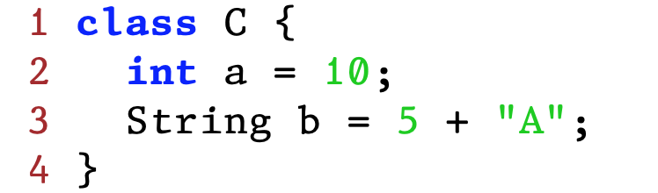
How many field definitions are in this class?

Slide 27
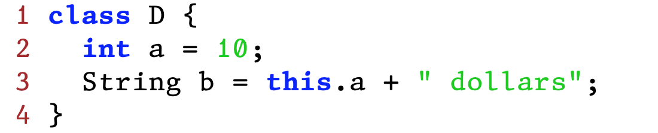
How many field definitions are in this class?

Slide 28
Do you think there's a limit on how many field definitions can be in a class?

Slide 29
Program Steps
class Example {
int x = 3 + 2;
int y = this.x * 4;
}

Slide 30
Expressions
int x = 3 + 2;
3 + 2
Arithmetic expression
Binary operator expression
int y = this.x * 4;
this.x
Field access expression
this.x * 4
Arithmetic expression where the left-hand operand is a field access expression

Slide 31
Methods
New class – MethodExample
In programming, we often want to describe a computation once
Then reuse it on different numbers, or different values
Write once, use it over and over again
Example:
Take two numbers and add up their squares
int sos1 = 3 * 3 + 5 * 5;
int sos2 = 4 * 4 + 7 * 7;

Slide 32
Define a method to do the same thing
int sumSquares(int n, int m) {
return n * n + m * m;
}
Vocabulary:
Method definition
Parameters
Method body
return keyword

Slide 33
Running it…
Method definition doesn’t change what prints out or any of the fields
Run command – only prints out the values of the fields
Can use sumSquares() to do the calculation
int ans1 = this.sumSquares(3, 5);
int ans2 = this.sumSquares(4, 7);
Vocabulary:
Called the method
Arguments

Slide 34
Methods: one of the building blocks for building programs
Not just useful for arithmetic
Useful for many more things
Why do we care about methods?
Methods give us a centralized place to write a calculation
Change in one place, every place that uses the method will see that update
As program gets large:
Might have 100s of places where we want to use a formula or calculation
Update them all by changing one place
Methods are self documenting – with meaningful names

Slide 35
class MethodExample {
int sumSquares(int n, int m) {
return n * n + m * m;
}
int ans1 = this.sumSquares(3, 5);
int ans2 = this.sumSquares(4, 7);
}

Slide 36
Method definition

Slide 37
class MethodExample {
int sumSquares(int n, int m) {
return n * n + m * m;
}
int ans1 = this.sumSquares(3, 5);
int ans2 = this.sumSquares(4, 7);
}

